Slide 1
Today’s class
Human Computer Interface (HCI)
Human Computer Interface - HCI
Notes:
Saturday, November 17, 2007
Computer Architecture I - Class 14

Slide 2
Human Computer Interface (HCI)
USIU
School of Science and Technology
Summer 2015
By
Nyamweya Nyagwencha, Justus
Human Computer Interface - HCI
Notes:
Saturday, November 17, 2007
Computer Architecture I - Class 14

Slide 3
Professor’s Profile
Educational Background
    Ph.D. (CS&SE) 2013
      Samuel Ginn College of Engineering,
      Auburn University
      The Agricultural and Mechanical Polytechnic and State University of Alabama
    MSc Computer Science JSU, Mississippi -2005
    BSc IT,JSU, Mississippi – 2000
    Dip. Civil Engineering, JKUAT -1998
    KCSE 1993, St. Josephs’ Mukasa Matibo Secondary, Matibo, Oteri ya Abuga
Human Computer Interface - HCI
Notes:
Saturday, November 17, 2007
Computer Architecture I - Class 14

Slide 4
Professor’s Profile
Teaching Exp.
  Assistant professor and Graduate Coordinator
    Hampton University, Hampton VA, 2014-2015 –Current
  Lecturer / Visiting Professor
    Spelman College, Atlanta GA, 2012-2014
Human Computer Interface - HCI
Notes:
Saturday, November 17, 2007
Computer Architecture I - Class 14

Slide 5
Professor’s Profile
Christian
  Attends SDA, Catholic.
Family Life
  Married - 2 Daughters
    Dr. Heddinah Kemunto Otete, Wife (Current)
    Naya Tichi Nyamweya (4.2 years)
    Zuri Boke Nyamweya (2.8 year)
Recreational
  Cross country, Track and Field
    Scholarship to USA, January 1998
    Golf
Political Party affiliations: Republican (USA)
Human Computer Interface - HCI
Notes:
Saturday, November 17, 2007
Computer Architecture I - Class 14

Slide 6

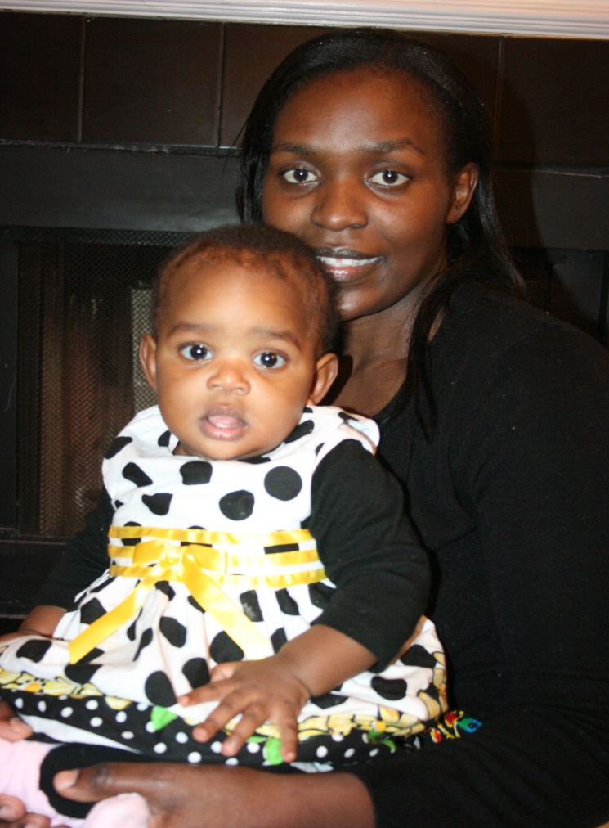
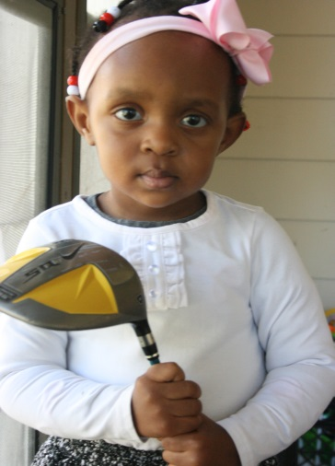
The Nyamweyas
Human Computer Interface - HCI

Slide 7
Required Text and Author
None
Cadle J., Yeates D. (2008). Project Management for Information Systems. 5th Edition, Upper Saddle River, New Jersey: Prentice Hall.
Bruegge B., Dutoit A.H. (2010). Object-Oriented Software Engineering Using UML, Patterns, and Java. 3rd Edition, Upper Saddle River, New Jersey: Prentice Hall.
Dawson C. (2009). Projects in Computing and Information Systems: A Student's Guide. 2nd Edition, Boston, Massachusetts: Addison-Wesley.
Human Computer Interface - HCI
Notes:
Saturday, November 17, 2007
Computer Architecture I - Class 14

Slide 8
Outline
Understand interdisciplinary theoretical foundations of the field of Human-Computer Interaction;
Use practical approaches to translating the theory into building and evaluating interactive systems
Perform research tasks and provide solutions
Critically analyze and report on an HCI topics
Human Computer Interface - HCI
Notes:
Saturday, November 17, 2007
Computer Architecture I - Class 14

Slide 9
Outline- cont
Have hands on experience in designing or modifying and experimentally evaluating an interactive system.
Demonstrate how to initiate a User Interface projects and define its modular structures
Perform requirements engineering in a leadership role or as part of a team, define project scope and human resource planning
Formulate, visualize, synthesize and communicate HCI designs
Perform Project Monitoring and Control, Use interface testing and deploy system components
Human Computer Interface - HCI
Notes:
Saturday, November 17, 2007
Computer Architecture I - Class 14

Slide 10
Golden rule of Design
“The best designers sometimes disregard the principles of design. When they do so, however, there is usually some compensating merit attained at the cost of the violation. Unless you are certain of doing as well, it is best to abide by the principles”.
Human Computer Interface - HCI
Notes:
Saturday, November 17, 2007
Computer Architecture I - Class 14

